Slide 1

GIS Application on PDA
Kumpon Boonwong 46010036 4D/1
Kiattichai Kitikan 46010062 4D/1
Dr. Chutimet Srinilta

Slide 2
Contents
Introduction
Related Theory
System Design
Experiment
Conclusion

Slide 3
Introduction
Scope
GIS
KMITL Campus
Web Services,J2EE
Add Your Text
Mobile Application,J2ME
Add Your Text

Slide 4
Related Theory
Geographic Information System (GIS)
  Organization
    Hardware
    Software
    People
    Data
  Data Type
    Spatial Data
      Vector format
      Raster format
    Attribute Data

Slide 5
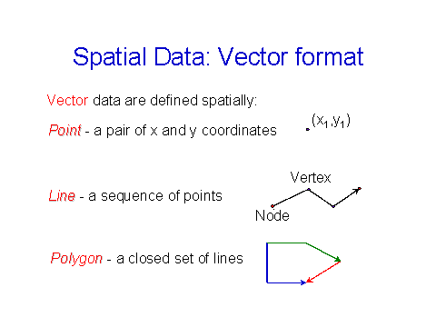
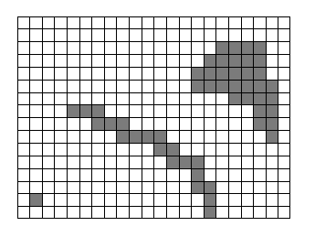
Related Theory
Geographic Information System (GIS)
  Vector Format Raster Format

Slide 6
Related Theory
Coordinate System
  Geographic Coordinate (Lat/Long)
    Longitude => -180 to 180 Degree (West to East)
    Latitude => -90 to 90 Degree (South to North)
  Grid Coordinate (UTM)
    Divide Latitude -80 to 84 degree into 20 block
    Divide Longitude -180 to 180 degree into 60 block

Slide 7
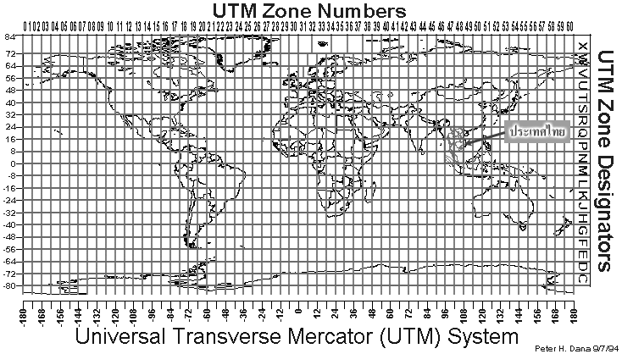
Related Theory
Coordinate System
  UTM

Slide 8
Related Theory
Global Positioning System (GPS)
  Reading data
  $GPRMC,225446,A,4916.45,N,12311.12,W,000.5,054.7,191194,020.3,E*68
  225446 => Time of fix 22:54:46 UTC
  A => Navigation receiver warning A = Valid position, V = Warning
  4916.45,N => Latitude 49 deg. 16.45 min. North
  12311.12,W => Longitude 123 deg. 11.12 min. West
  000.5 => Speed over ground, Knots
  054.7 => Course Made Good, degrees true
  191194 => UTC Date of fix, 19 November 1994
  020.3,E => Magnetic variation, 20.3 deg. East
  *68 => mandatory checksum

Slide 9
Related Theory
Web Services
  Organization
    Application
      Run on Server
    SOAP
      Protocol, Cross platform
    WSDL
      Web services description
    UDDI
      WSDL collection, publish

Slide 10
Related Theory
Scalable Vector Graphic (SVG)
  One of XML Language
  Display vector format image
  Zoom, Expand, Rotate and Animation
    Vector Graphic Shape
    Image
    Text

Slide 11
Related Theory
PostgreSQL
  Object-Relational Database
PostGIS
  Extension of PostgreSQL
  Handle manipulation of Spatial Data

Slide 12
Related Theory
J2ME architecture
  Host operating system
  Java virtual machine
  Configurations
    CDC
    CDLC
  Profiles
    Personal Profile
    MIDP

Slide 13
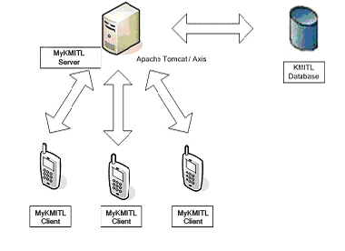
System Design
System Overview

Slide 14
System Design
Features
  Manage members – group and contact
  Manage calendar
  Manage announcement
  Display KMITL map with moving objects
    pan, zoom, rotate
    display object information – static and dynamic
  Search object by location and attributes
  Synchronize calendar with PDA’s
  Record path
  Online/Offline modes of operation

Slide 15
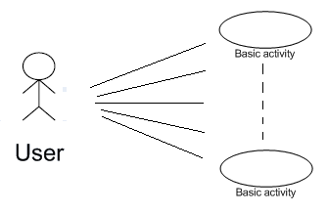
System Design
User Role
User

Slide 16
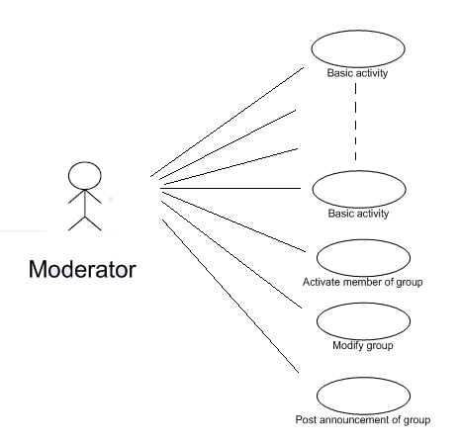
System Design
User Role
2. Moderator

Slide 17
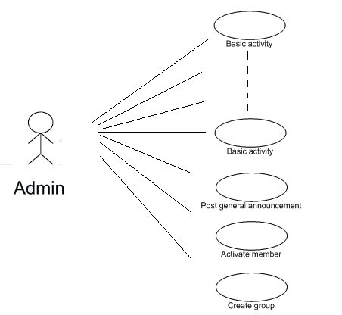
System Design
User Type
3. Admin

Slide 18
System Design
Tools and Technology
  Database
    PostgreSQL
  MyKMITL Server (Web Services)
    J2EE (Java)
    Jbuilder
  MyKMITL Client (Mobile Application)
    J2ME MIDP (Java)
    WTK and Eclipse

Slide 19
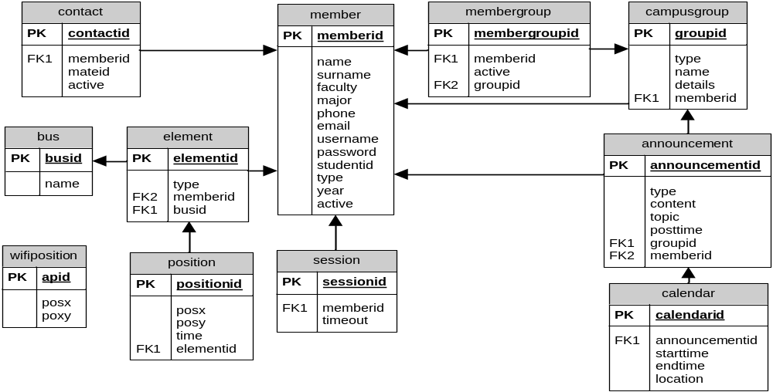
System Design
Database

Slide 20
System Design
Web Services
GetMapServices
AnnouncemenetServices
UserServices
GroupServices
PositionServices

Slide 21
System Design
Web Services : GetMapServices
listMapLayer
getMap
searchNearbyArea
searchNearestArea

Slide 22
System Design
Web Services : UserServices
signup
getProfile
getProfileList
getNoActiveProfileList
activateMember
editProfile
addContact
removeContact
activateContact

Slide 23
System Design
Web Services : AnnouncementServices
getAllAnnouncements
getAnnouncements
groupPost
groupPostAsCalendar
post
postAsCalendar

Slide 24
System Design
Web Services : GroupServices
createGroup
registerToGroup
getNoActiveMemberGroupList
activateMemberGroup
getGroupList
getAllGroupList
getDetails
updateDetails
departGroup

Slide 25
System Design
Web Services : PositionServices
getAllPosition
getContactsPosition
updatePosition

Slide 26
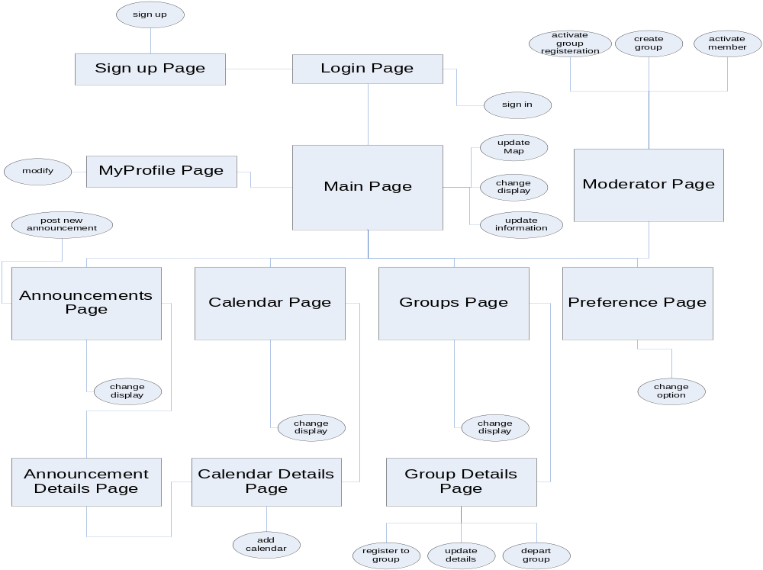
น้าจอหลักทันที แสดงได้ดังรูป 3.16
System Design
Mobile Application : Screen Navigation

Slide 27
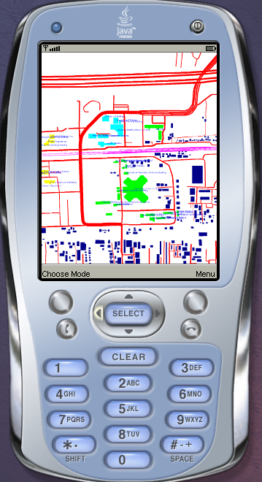
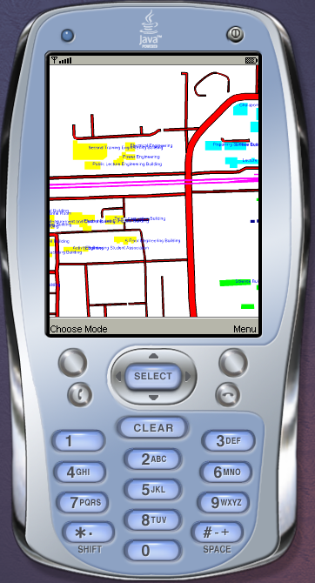
Experiment
Display map

Slide 28
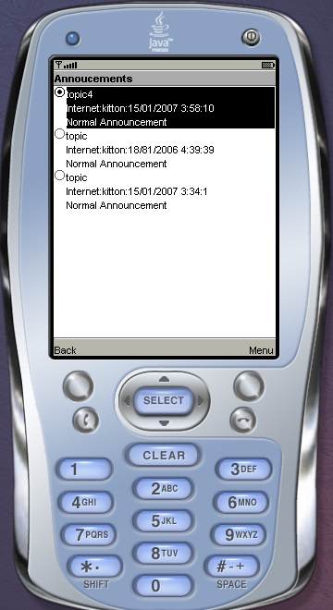
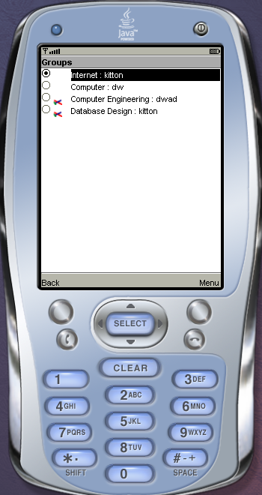
Experiment
Display announcement and group

Slide 29
Conclusion
Location-based GIS web services
  cross platform
  cooperation among servers
GIS Mobile application
  process and display SVG
  read data from GPS
  request web services
  calendar/announcement

Slide 30
Thank You !

